Slide 1

DevSkill - Competitive Programming - Beginner
Class 7 - Sorting ( Non-recursive )
Instructor : Md Sadman Sakib

Slide 2
Non recursive sortings
Insertion sort ( O(n^2) )
Selection sort ( O(n^2) )
Bubble sort ( O(n^2) )

Slide 3
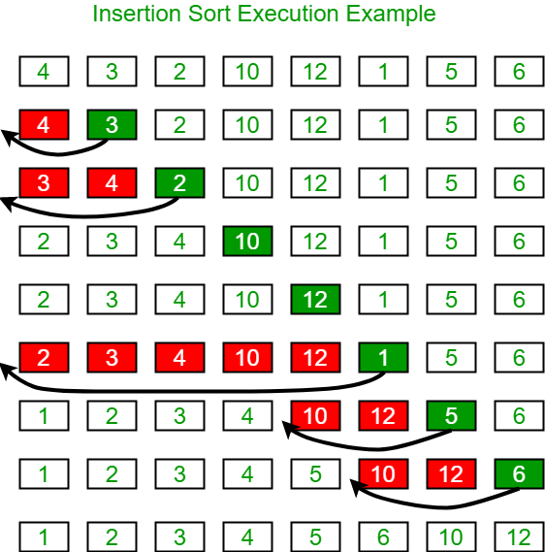
Insertion Sort

Slide 4
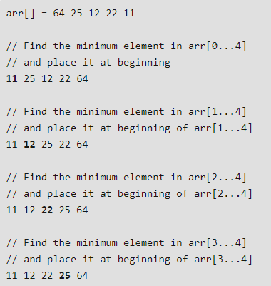
Selection Sort

Slide 5
Some interesting sortings!
Sleep sort
Bogus sort

Slide 6
Built in sort in c++
It is actually called “Intro sort” which is a combination of these sorting algorithms:
Quick Sort
Insertion Sort
Merge Sort

Slide 7
Questions?

